Slide 1
GPS Disciplined Frequency Reference
Traps for the Young and not so Young
George
VK4AMG
VK4AMG@yahoo.com.au
The ’flavor of the month’ seems to be GPS locking of radio frequency.
To some, being “GPS locked” is enough, however the result is often not good
This presentation aims to summarize my experimentation over the last year or more,
with frequency generators particularly the world of GPS disciplined frequency references,
getting to solutions and measured results that satisfied me
and to explain the traps identified while assisting others
This subject is not new. I may be presenting solutions published before my examination
I have learned there are many errors and “wrong drum” in published material

Slide 2

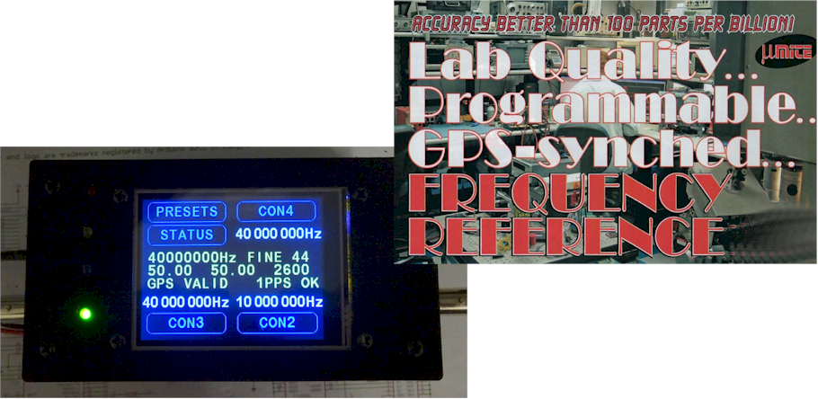
GPS Disciplined Frequency Reference
Traps for Young and not-so Young Players
If you own one of these
You will know
** Corrected * *
LOCKED !!
It isn’t as easy as the magazines describe

Slide 3
GPS Disciplined Frequency Reference
Traps for Young and not-so Young Players
Frequency Accuracy
  So the other station can find me when I call on sked
and
  when operating in digital modes
      To be on specific frequency
      To be reported correctly in reverse beaconing
Within 100 Hz up to 1296MHz
Frequency Stability
  So my SSB / CW signal is clear and interference free
  So others optimum decode digital modes
  decode software is time and frequency critical
  So decoding other’s digital transmission is not degraded
Preferably better than 10Hz
For all operating conditions;
Voltage, ambient temperature, power output, SWR, radio temperature, fan on/off

Slide 4
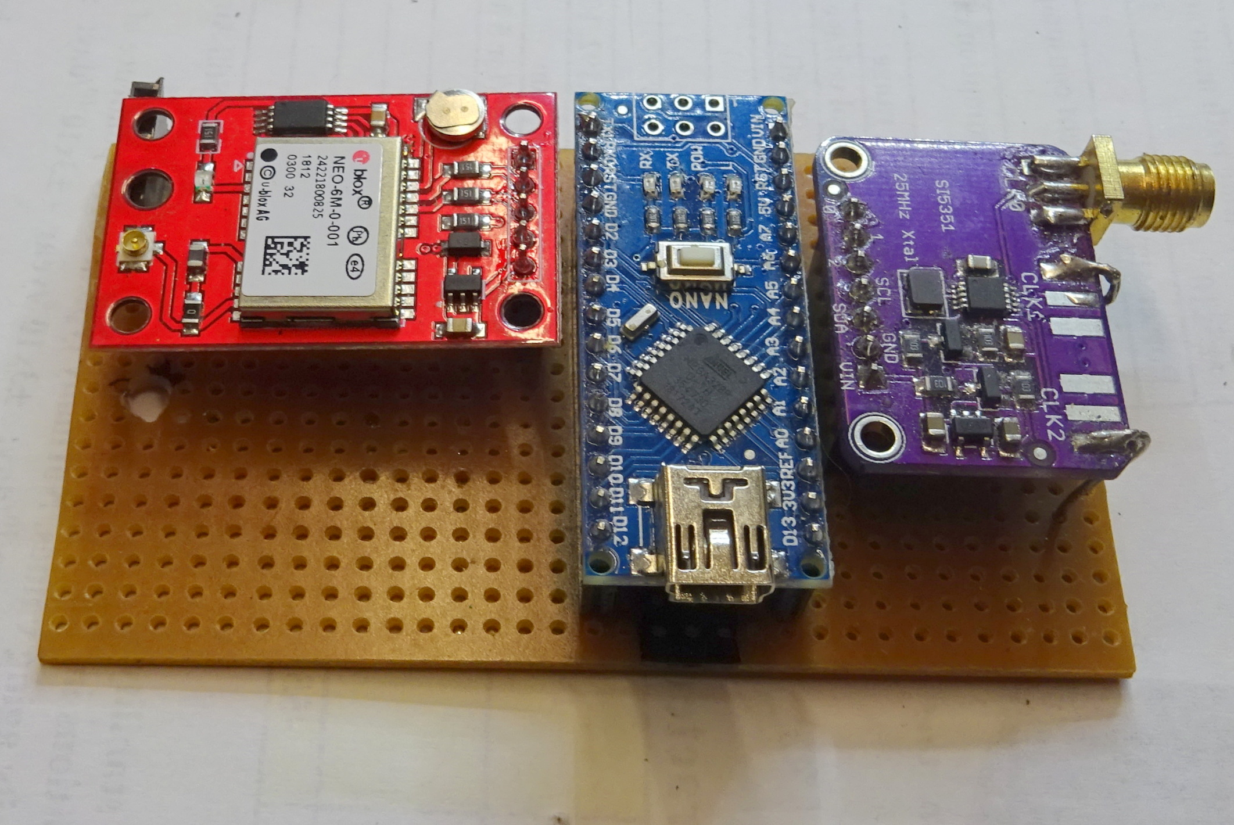
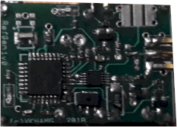
GPS Disciplined Freq Gen
Proof of Concept Hardware
uBlox Neo6
SI5351 module
27MHz
OP1
Clock Gen
Output
OP3
32MHz
SPI Comms
Fo/8
Arduino Nano
1PPS
‘Locked’
Timer
uP
GPS DO Ref Gen Module
GPS Rx
Int
Serial NMEA messages

Slide 5
Clock Generator e.g. Si5341
PLL1
25MHz
n/m
Int
Crystal
Oscillator
Phase
Det
Filter
VCO
1 30.2MHz
24
6944
Switch Matrix
29
1048575
725 MHz
PLL2
EEPROM
8 3.775MHz
SPI Bus
Logic
PLL3

Slide 6
Errors in GPS Disciplined Freq Gen in 30.2 MHz Ref Output
Include:
Granularity due digital divider +- 1 Hz Si5351
far more for 4.4 & 13.4 GHz
1PPS interrupt latency 1uS produces 4 Hz
Correction latency
e.g. Crystal drift of 10Hz in 10 secs 12 Hz
Frequency Count Resolution 1/8th freq 7 Hz
NB* 1 Hz shift in Reference Frequency results in 50Hz at 1296 MHz operating frequency
40 ppb = 0.04ppm
Errors are additive e.g. >20 Hz at 30.2 MHz approx. 1 ppm 850 Hz at 1296 MHz

Slide 7
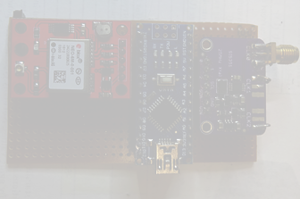
GPS Disciplined Frequency Generator
Advantages
Simple low-cost hardware
Freq ranges 200kHz to 200MHz
138MHz to 4.4GHz
138MHz to 13.4MHz
Crystal frequency source for PLL
  Low cost
Disadvantages
Frequency accuracy limited by:
  Max Frequency of uP counter
  GPS and uP Interrupt Timing Jitter
  Frequency Count resolution
  Granularity of Freq Gen PLL and digital dividers
Frequency Stability limited by:
  Latency in frequency count
  Latency in applying corrections
  Crystal affected by ambient temp

Slide 8

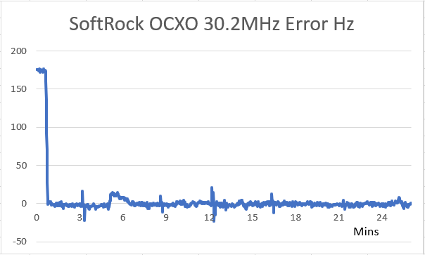
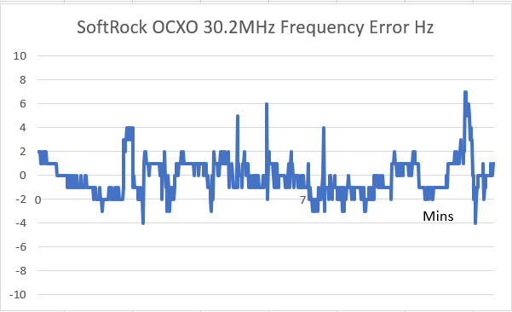
Performance GPS Disciplined Freq Gen 30.2 MHz
Arduino Nano 3V 8MHz Neo6 1PPS
QRP Labs 27MHz Si5351 OCXO
IC910H 27MHz OCXO Measure & Calculate 3.775MHz every sec Average error over 8 secs Applied 10 Secs

Slide 9
Overcoming Errors
Granulatity – Can’t be avoided – Use highest PLL frequency
Carefully select integer and fractional divide
Interrupt latency - Processor selection – highest uP clock
Code structure – avoid blocking functions
Simple IRQ servicing code
Frequency count over multiple 1PPS
Correction latency crystal selection – minimise frequency drift
insulated environment
heated environment OCXO
Frequency Counter - Select uP with async external input to timer
- Avoid resetting timer and overflow
- Count over multiple 1PPS periods e.g. 8 at 1/8th
- Adopt Coarse / Fine Count & Correction
Coarse 8 secs 1Hz Fine 80 secs 0.1Hz
- Average Count or Rolling Average of Error

Slide 10
Other Factors
Correct by Fuzzy Logic not processor intense PID Controller
Consider count certainty in selecting dead band
Avoid compiled code structures known to be unfriendly to embedded uP
e.g Variable arrays Select Case Indexed For Loops
Use specific frequency generator code not processor intense general case
Use device specific comms protocols updating only essential parameters
Avoid resetting frequency generator part unless necessary
not necessary for small changes
Customise constants for specific hardware
e.g don’t software correct for nominal crystal use
close match considing operating conditions
It is not easy – Having GPS and a modern uP do mean that all will be well

Slide 11
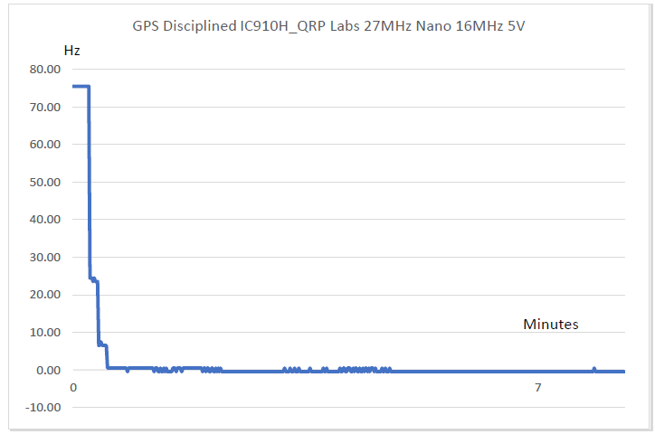
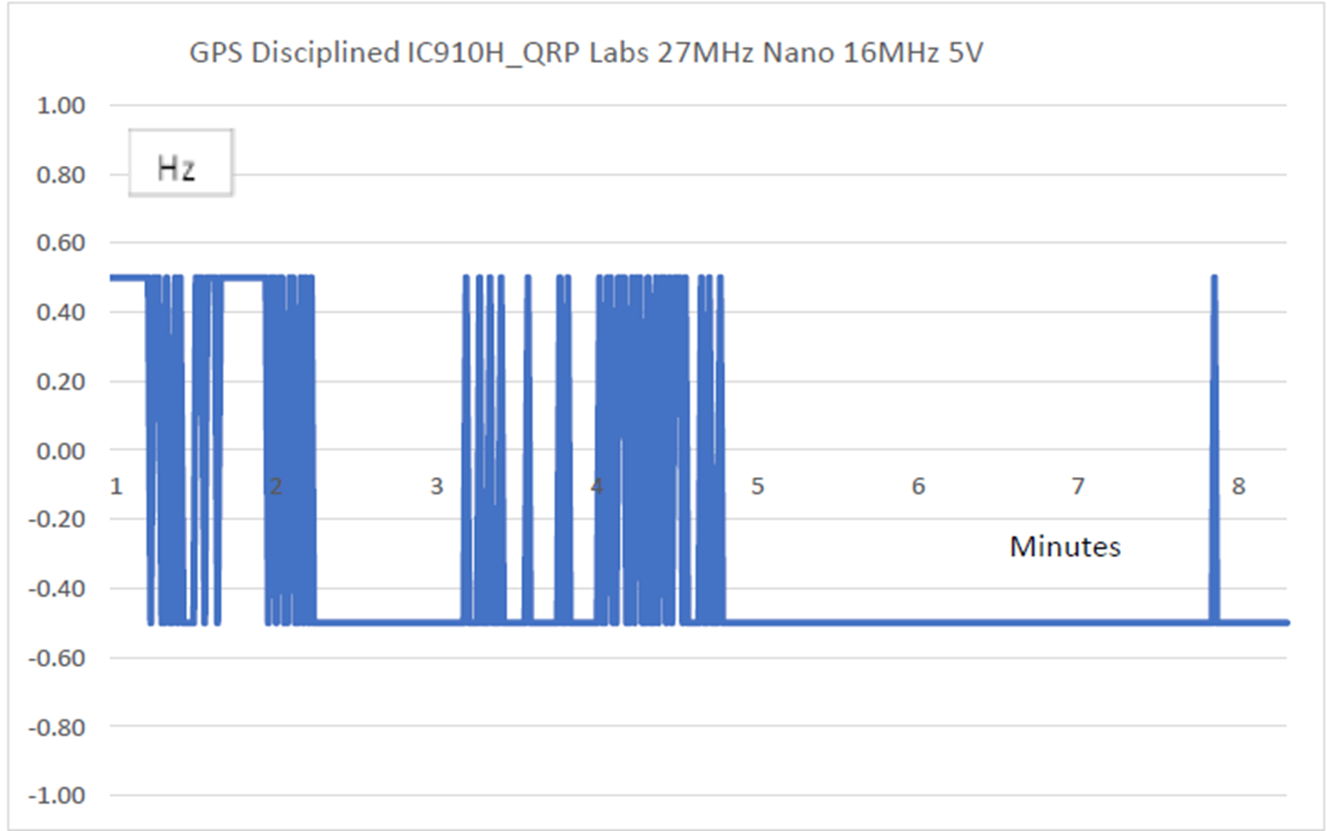
GPS Disciplined Freq Gen 30.2 MHz
Nearly Perfect but ….
Is it good enough ? ? ?
Arduino Nano 5V 16 MHz Neo6 1PPS
QRP Labs 27MHz Si5351 Synthesiser
IC910H 27MHz OCXO Measure 7.75MHz over 8 secs then Calculate Rolling error over 8 sec Applied 10 Secs
More than a thousand hours of research, hardware and software development, testing, and modifications later
This design minimised all errors, resulting in stability equal to the granularity of Si5351 (1Hz @ 30MHz)

Slide 12
Alternative Approach Away with Quantization Errors
Errors of the above GPS disciplined Frequency reference are avoided
by Ref Gen or PLL locked to 10MHz Frequency Standard
IC7400 2m
MC145170
PLL
IC7400 2m
GPS Disciplined
10MHz
Oscillator
“Cal”
32 MHz
Ref Gen
IC910H 23cm
30.2 MHz
Freq Counter
Digital Modes
PC
A whole shack solution
Spectrum Analyser
Frequency and time
NMEA RMC
Time Sync

Slide 13
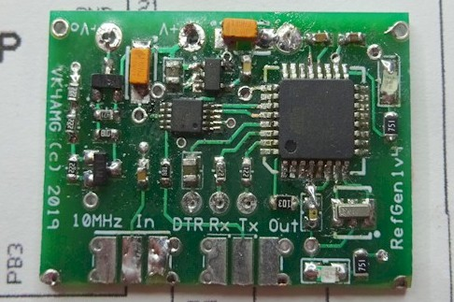
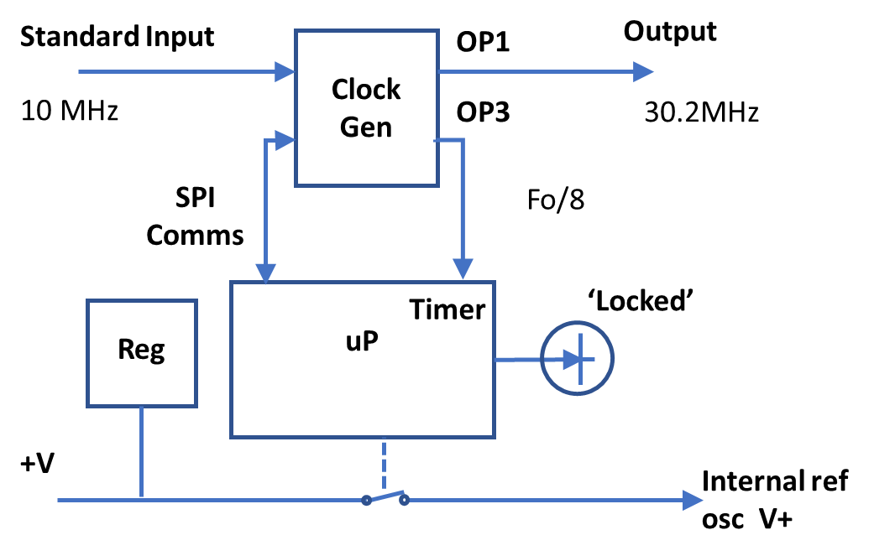
10Mhz Locked Frequency Generator
uP functions minimised
  Initialise Clock Gen
  Detect 10MHz Standard
  Enable output of Clock Gen
  Switch off supply to radio ref
Similar hardware, no GPS, depending on external 10MHz Standard to avoid quantisation errors
May be applied to most modern radio designs using an Internal Frequency Reference (incl SDR)

Slide 14
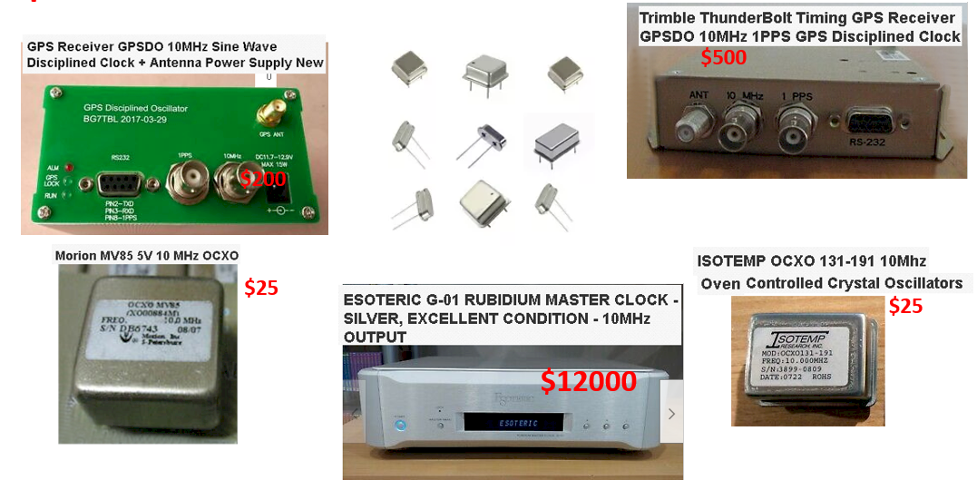
Options for 10MHz Reference
Accuracy Stability / Day Price
Rubidium / Caesium Frequency Standard 0.001ppb 0.001ppb Used $500++
GPS Disciplined Oscillator 0.01 ppb 0.01 ppb
e.g. Trimble Thunderbolt Used $500
G7TBL GPSDO New $300
Oven Controlled Crystal Oscillator Not Calibrated 0.5 ppb
e.g. Morion MV89 Used $50
IsoTemp-131 Used $50
Temperature Compensated Crystal Oscillator Not Calibrated
e.g. SiTime 5356AI 0.1ppm New $75
IQT LF TVX009900 0.2ppm New $20
CTS 580L100X2 0.25ppm New $20
Voltage Controlled Crystal Oscillator Not Calibrated
e.g. AVVV -10MHz I25 25ppm New $20
The lower cost options may be Manually Calibrated or GPS Disciplined
And must be insulated from environment or otherwise temperature controlled Temp compensated not enough.

Slide 15
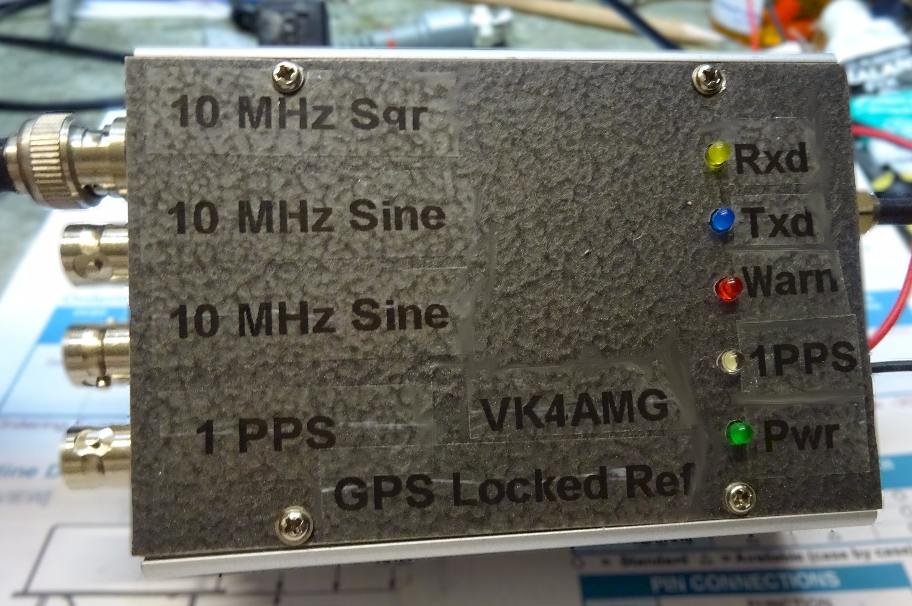
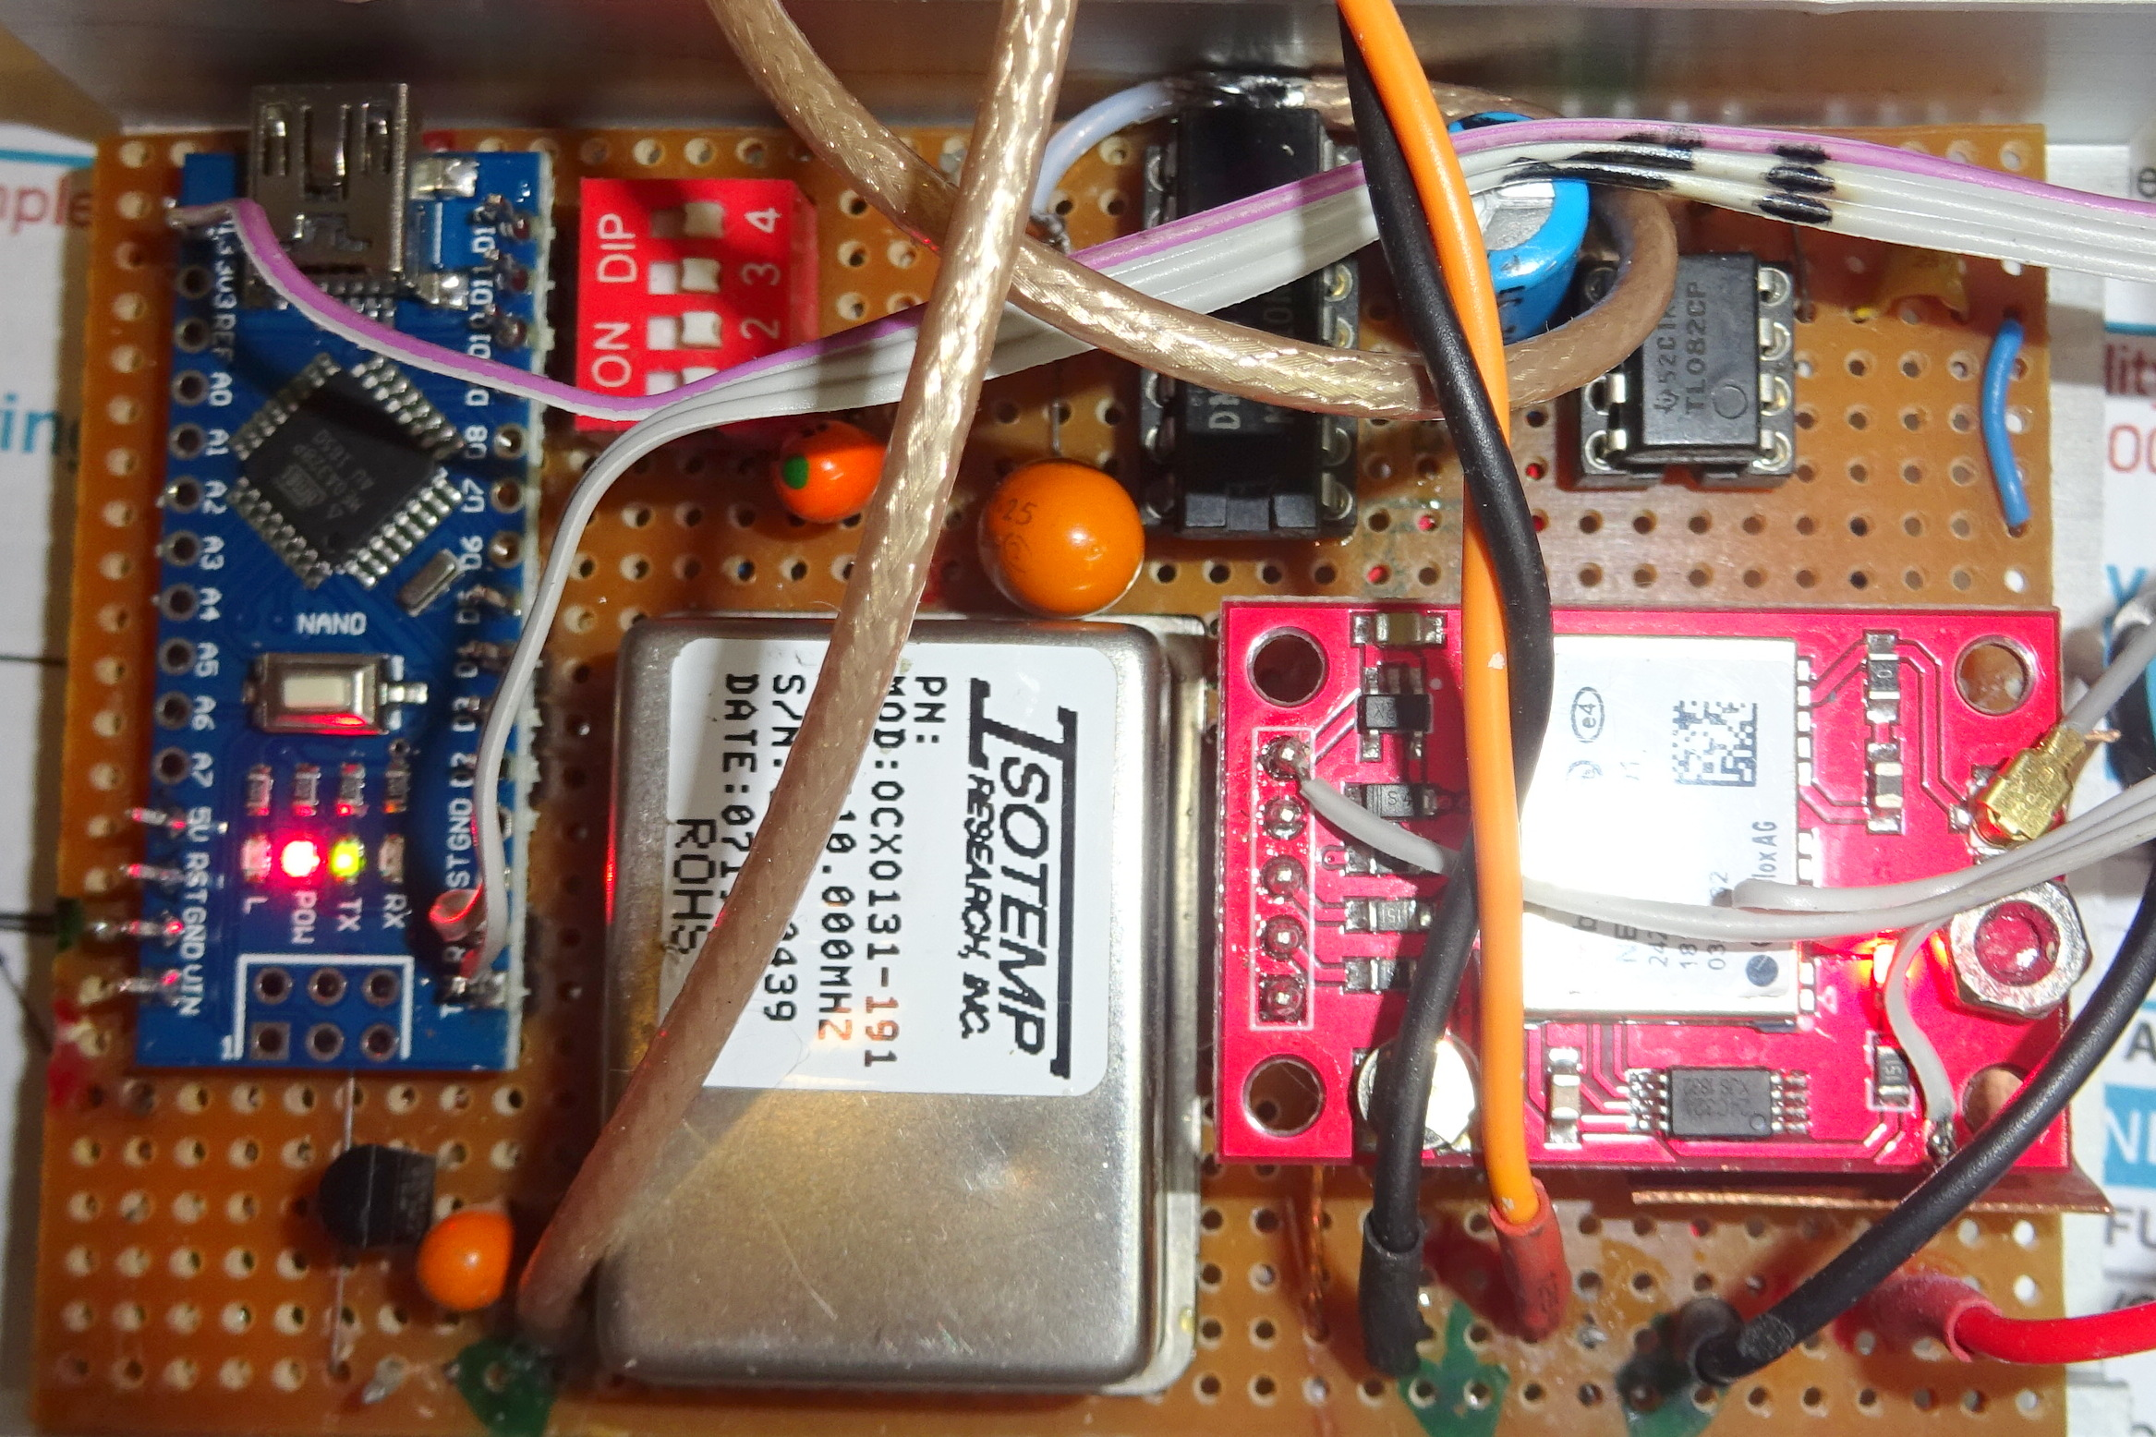
GPS Disciplined 10Mhz Oven Controlled Oscillator
TCXO
10MHz
IsoTemp-131
Output
10MHz
0 -> 8V
2
Level Shifter
Le
5MHz
PWM
Timer
‘Locked’
GPS Rx
1PPS
uP
Int
Arduino Nano 5V 16 MHz
Neo6
Serial
Configure for NMEA RMC only
Serial NMEA messages

Slide 16
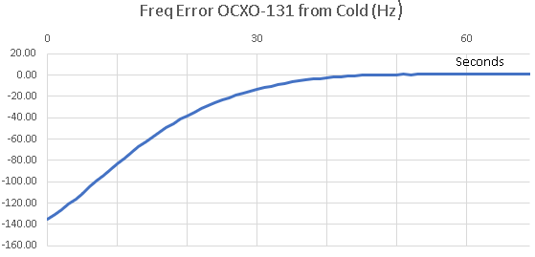
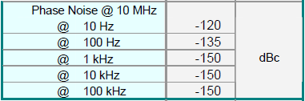
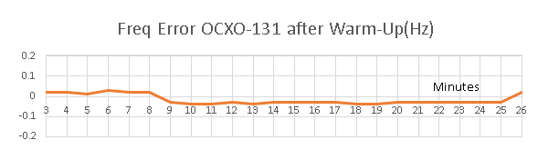
GPS Disciplined 10MHz IsoTemp-131 VCXO
OCXO excellent accuracy +- 20 ppb Uncorrected
Fine Pulling Range +- 4ppm
Supply 12V at less than 12W < 1.5W quiescent
Control range 0 – 8 V dc PWM Level Shifter or AD7243
Sine wave output at +8 dBm
Disciplined Accuracy < + - 2 ppb
Fast turn-on Use last correction (EEPROM) after warm-up
Little or no discipline necessary
Use not disciplined - occasional calibration

Slide 17
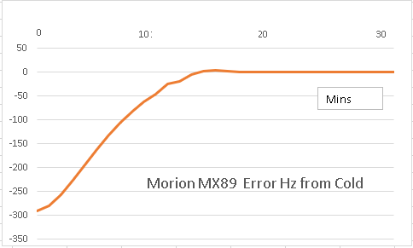
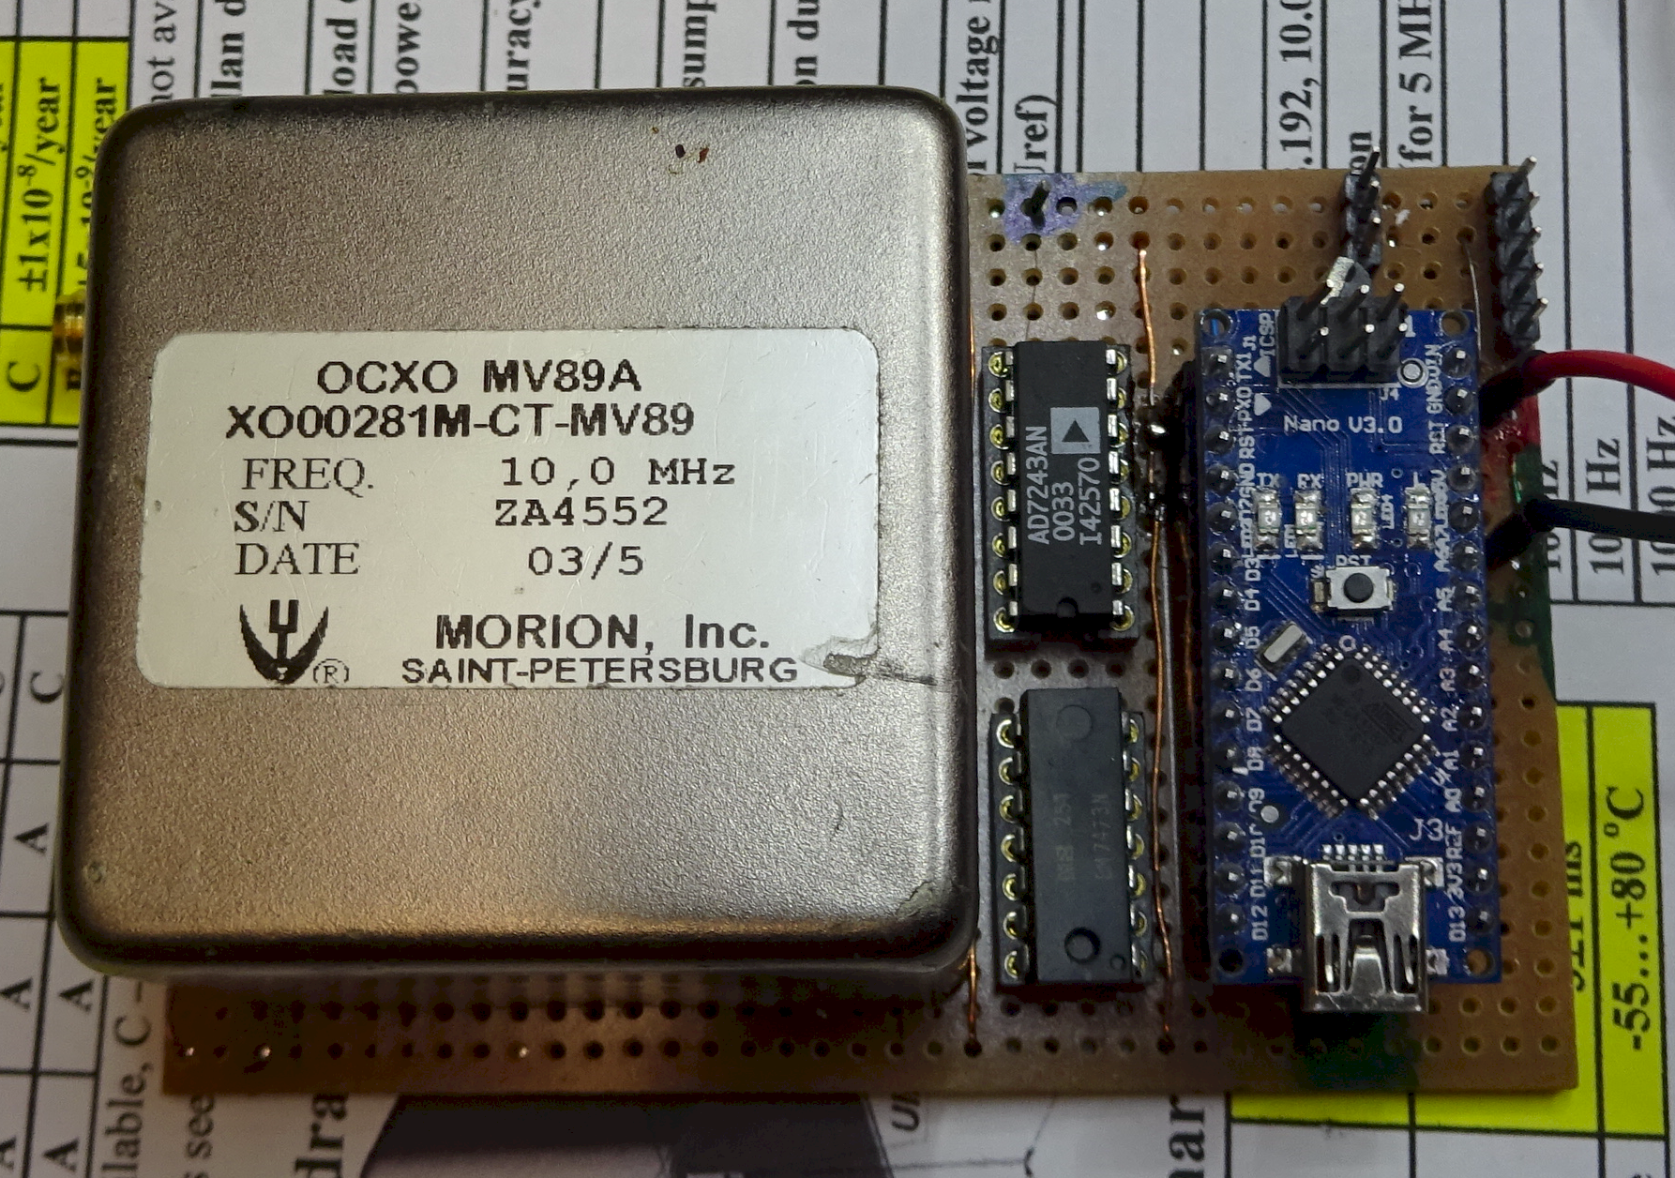
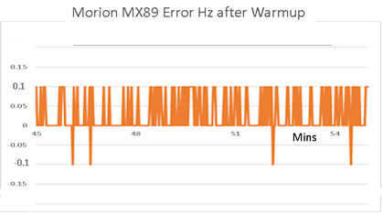
GPS Disciplined 10MHz Morion MX89 TCXO
Output 10MHz sine +7dBm
Stability < 0.0002 ppb
Power Supply 12V @1.5A warmup 350mA Quiescent
Warmup 15 minutes
Pulling Range 25 ppm
Pulling Volts 0 -> 5V
+- 1 Count on HP5384

Slide 18
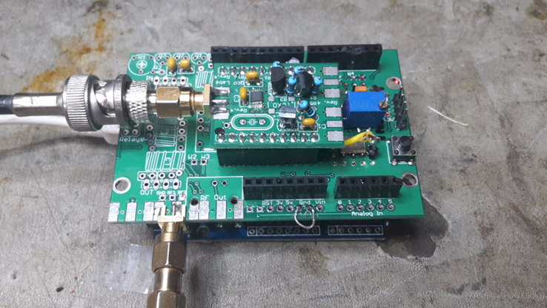
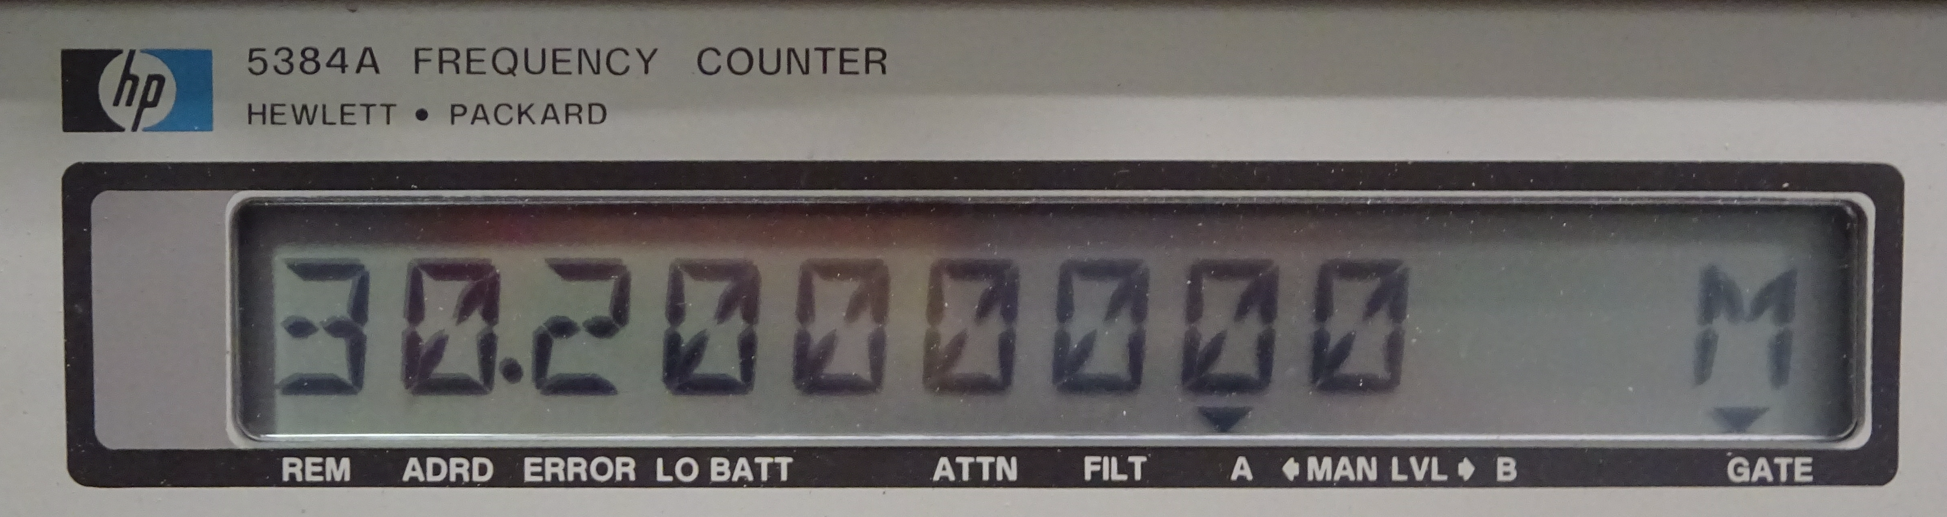
GPS Disciplined VCXO in Freq Gen Also away with Quantisation Error
OP1
Output
27MHz +-
VCXO
Clock Gen
OP3
30.2MHz
Fo/8
PWM
SPI
Timer
‘Locked’
1PPS
GPS Rx
Int
Microprocessor
Granularity issues avoided
Frequency count, VCXO control, & stability controllable

Slide 19
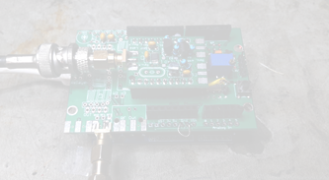
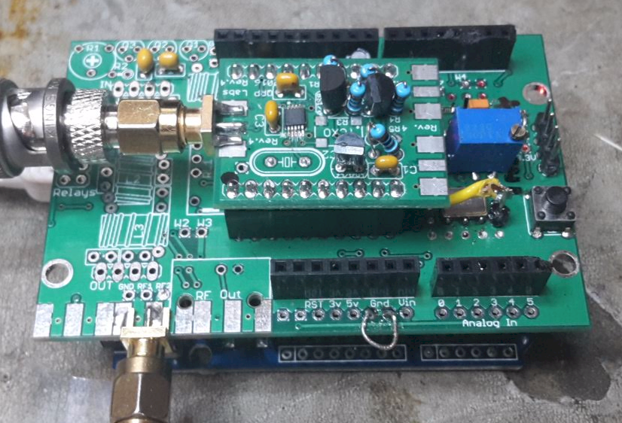
Improved ‘Prog Rock’ - GPS Disciplined ASVV VCXO
Arduino Uno QRP labs “Soft Rock” Si5351 module on QRP Shield
27 MHz VCXO mounted on Arduino Uno shield is controlled by PWM from Timer 1
PWM is filtered via two stage RC filter 27ms and 270ms time constant
One tenth of DC control signal is mixed with split 3V3 reference signal
Network provides +- 1.5 kHz control range with 2¹⁶ -1 steps (1 ppb)
Si5351 OP3 provided <5MHz to Timer 1 for Counting and PWM generation
16 MHz Arduino Uno AT328n Timer measures 5MHz with excellent repeatability
Eight successive frequency counts are added to calculate frequency error
Rolling average of error is calculated over eight further seconds
This error is applied by fuzzy logic to PWM duty cycle
Thirty second settling period allowed between corrections
Less than five minutes is required to settle output within 10Hz
Another 5 to 10 minutes settles the output frequency to better than 1 Hz accuracy
NB: ASVV VCXO is affected by ambient temperature changes Typically + - 25 ppm
Temperature, counting, correction errors need to be considered and controlled

Slide 20
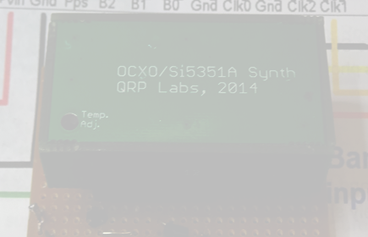
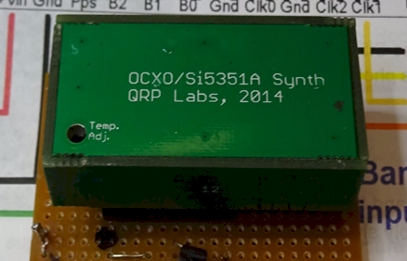
OCXO Si5351 Synthesizer
This module aims to improve on the ‘Prog Rock’
Provides temperature-controlled oven
Isolate load from crystal oscillator
Improve power supply regulation and isolation
Claims better than 1 ppm stability (enough ???)
over 2 minutes WSPR transmission
In QRP Lab application of WSPR beacon
frequency is not measured during transmission
Frequency discipline may use GPS 1PPS over long term
I have not attempted to measure of compare the QRP Labs modules for frequency accuracy
Comments on potential error for other GPS Disciplined Si5351 and AT328P modules apply
Combining “Improved “Prog Rock” with QRP Labs OCXO should provide a 1ppb accuracy & stability

Slide 21
Conclusions
Modern Digital modes require high frequency accuracy and stability
as well as accurate timing
Digital Frequency Generators have quantisation limitations
which cannot be overcome
Combination of 10MHz “Standard” feeding PLL or
Frequency Generator provides good result
GPS disciplined VCXO may be combined with digital Frequency Generator
to provide a good result
10MHz “Standard” or VCXO with Freq Gen must be insulated
from temperature changes
For more info on Silicon Chip Freq Gen – send email with info / photos of your attempt
VK4AMG@yahoo.com.au

